Slide 1
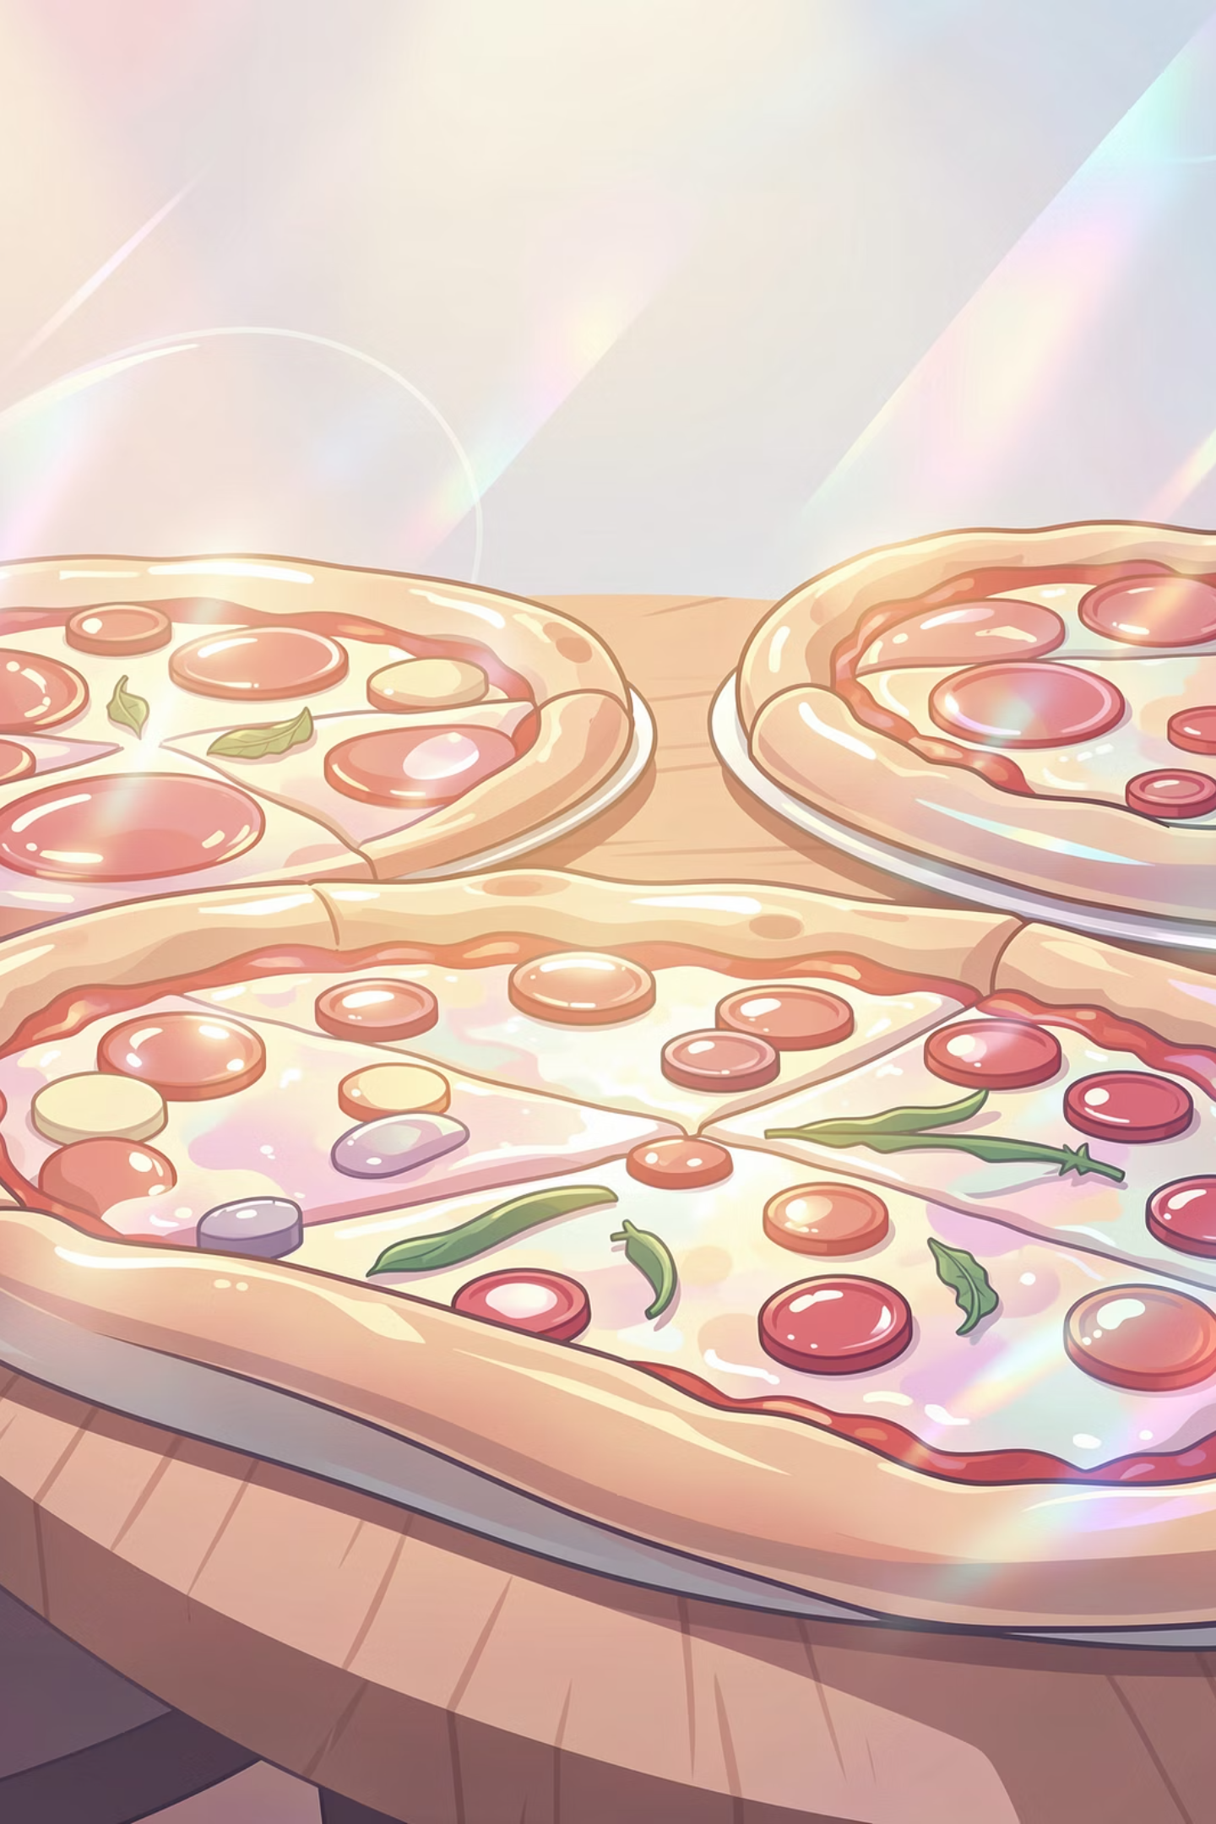
Pizza Sales Analysis Report
Data-driven insights from 3,582 orders and $152,745 in revenue

Slide 2
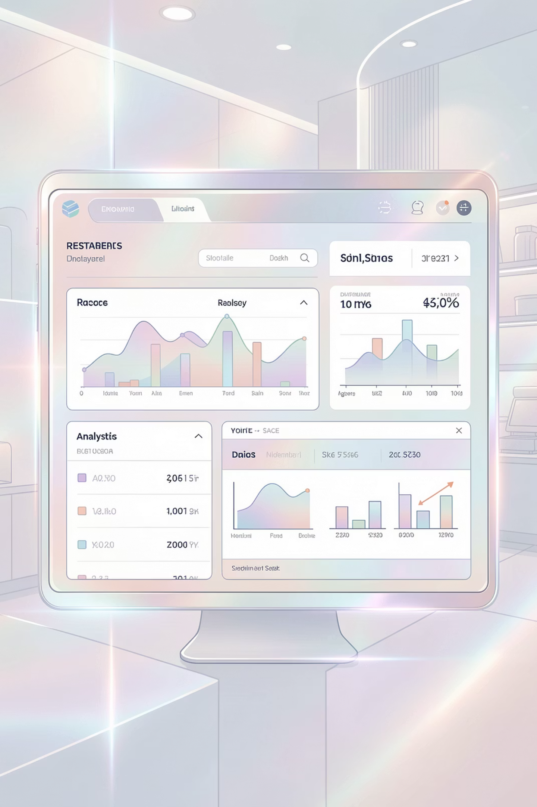
OVERVIEW
Dataset at a Glance
3,582
$153K
21,350
Total Orders
Total Revenue
Pizzas Sold
Analyzed across all categories
Generated from pizza sales
Across all sizes and types

Slide 3




Top Revenue Generators
Thai Chicken Pizza
Barbecue Chicken Pizza
California Chicken Pizza
Key Insight
$43,434 revenue leader
$42,768 in sales
$41,410 revenue
Top 28% of menu items drive majority of revenue
Classic Deluxe Pizza
Strategic Focus: Emphasize high performers in promotions and inventory planning
$38,181 in sales

Slide 4
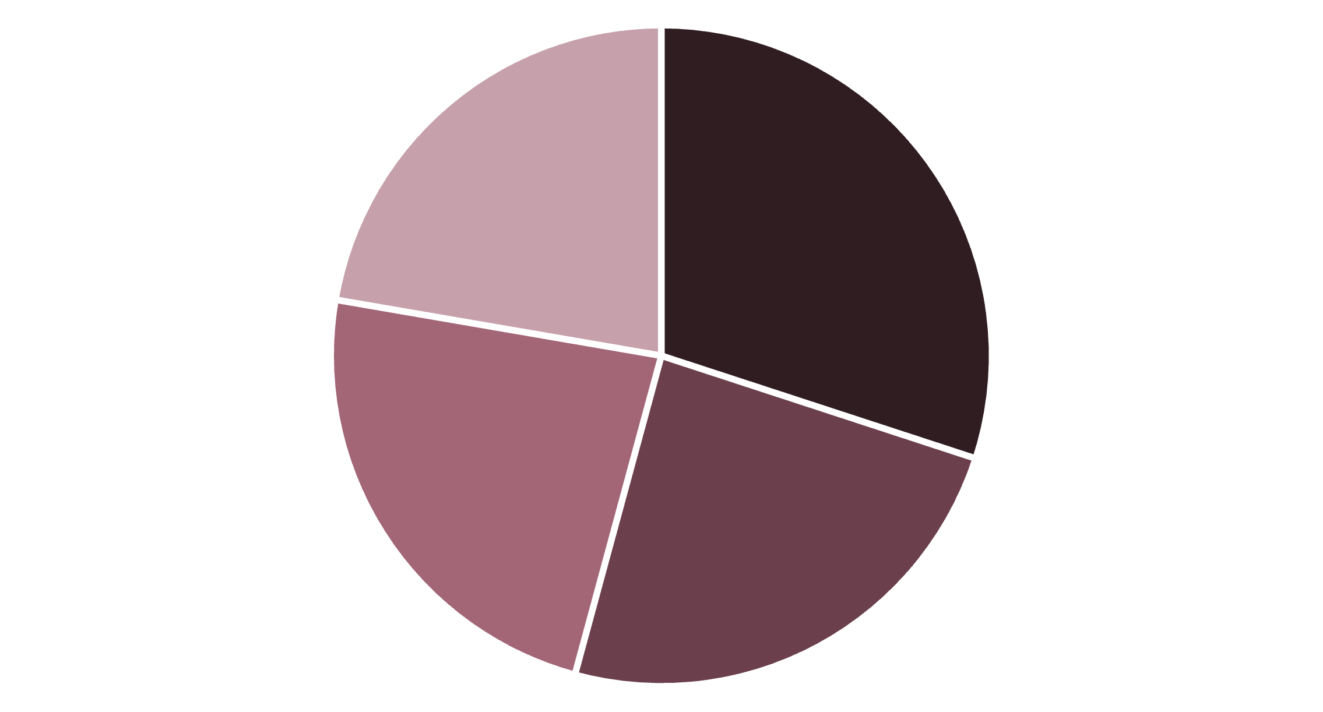
Category Performance Breakdown
Category Distribution
Classic pizzas lead with 31% of orders, followed by Supreme at 25%
Classic
8 varieties
Supreme
9 varieties
Veggie
9 varieties
Chicken
Classic
Supreme
Veggie
Chicken
6 varieties

Slide 5
Size Preferences Drive Orders
Customer Size Choices
Large pizzas dominate with 38% of total orders
38%
32%
Large
Medium
18,526 orders
15,335 orders
29%
1%
Small
XL/XXL
14,137 orders
572 orders

Slide 6

Peak Demand Hours
62% of orders occur during lunch and dinner periods
1
11 AM - 1 PM
Lunch rush: 6,206 orders
2
5 PM - 7 PM
Dinner peak: 6,744 orders
3
8 PM - 10 PM
Evening orders: 3,498

Slide 7

RECOMMENDATIONS
Strategic Action Plan
Menu Optimization
Inventory Planning
Promote top revenue pizzas in bundles and featured items
Align ingredient procurement with high-demand categories
Staff Scheduling
Pricing Strategy
Allocate workforce during lunch and dinner peaks
Test price elasticity on popular sizes for revenue growth

Slide 8

Key Takeaways
Revenue Concentration
Top 28% of menu drives majority of sales
Predictable Demand
62% of orders during peak lunch and dinner hours
Size Matters
Large pizzas account for 38% of all orders
Data-Driven Growth
Apply insights to boost revenue and customer experience

